Slide 1
Exploring Neighborhoods in NYC
Identifying an ideal neighborhood for Opening an Indian Restaurant
By Asia Shazmi

Slide 2
Introduction
In this project we will go through a step by step process to make a decision whether it is a good idea to open an Indian restaurant in NYC.
We analyze the neighborhoods in NYC to identify the most profitable area since the success of the restaurant depends on the people and ambience.
Since we already know that NYC shelters a greater number of Indians it is a good idea to start the restaurant here, but we just need to make sure whether it is a profitable idea or not. If so, where we can place it, so it yields more profit to the owner.
This data science capstone project deals with the process of leveraging location data acquired from data providers such as Foursquare to explore the neighborhoods within a targeted city and create clustering models.

Slide 3
Data Exploration
The data for this project will be extracted, processed and analysed by integrating the borough information for New York City extracted from the web and venue related information acquired through Foursquare API.
The data extraction from web shall be done using the web scraping libraries for python.
After extracting the html page the information shall be converted into a dataframe using the pandas python library.
Using the pandas library, the data will be cleaned and processed to prepare a final data frame for analysis. In order to render my data onto a map, I will be using the Folium library.
To create clusters of similar regions of interest, I will be using k-means clustering technique.

Slide 4
Data Sources
I am using the "https://cocl.us/new_york_dataset" page to get all the information about the neighborhoods present in New York City. This page has the borough & the name of all the neighborhoods, Latitude and Longitude present in New York city.
Then “https://en.wikipedia.org/wiki/Neighborhoods_in_New_York_City” page to get all the population details of the neighborhoods.
To get location and other information about various venues in New York City I’m using Foursquare’s explore API. Using the Foursquare’s explore API (which gives venues recommendations), I’m fetching details about the venues present in New York City and collecting their names, categories and locations (latitude and longitude). From Foursquare API (https://developer.foursquare.com/docs)

Slide 5
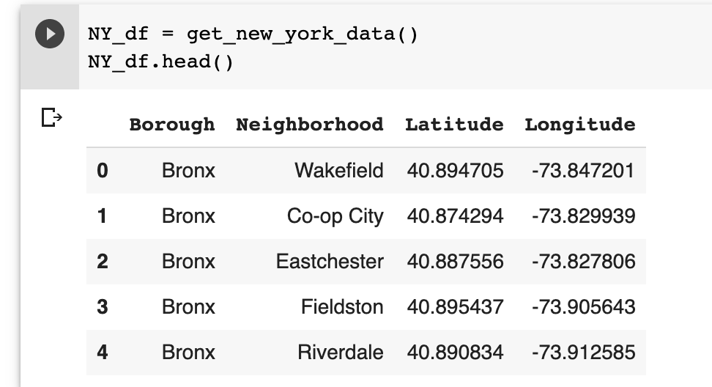
Data Cleaning
Scraping New York City Neighborhoods:
Scraped the following Wikipedia page, “https://cocl.us/new_york_dataset" in order to obtain the data about the New York City & the Neighborhoods in it.

Slide 6
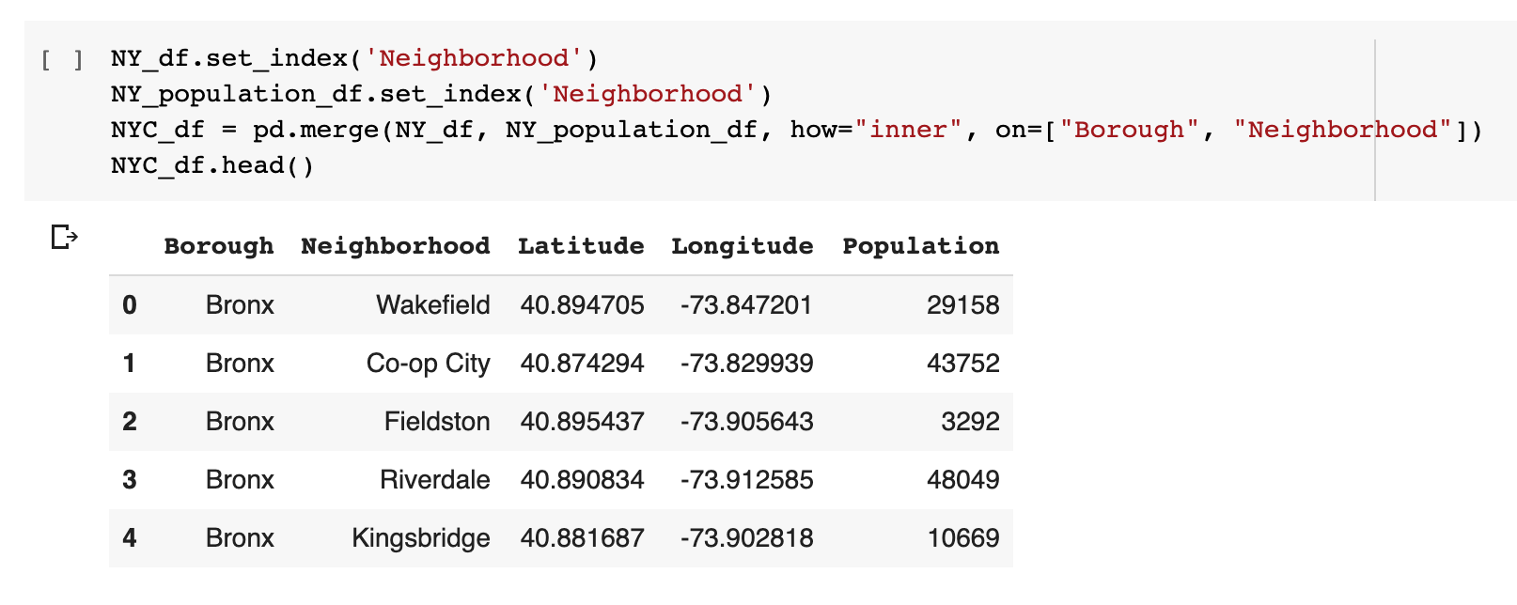
Data Cleaning Contd:
b) Population Data from Wikipedia:
Once we get the New York Geospatial data, population data is added to the respective Neighborhoods.

Slide 7
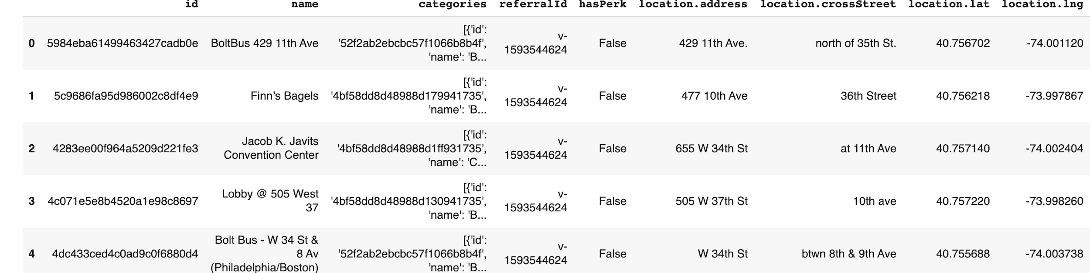
Data Cleaning Contd:
c) Get location data using Foursquare
Foursquare is used to retrieve information about the places present in the neighborhoods of New York City. The API returns a JSON file and we need to turn that into a data-frame.

Slide 8
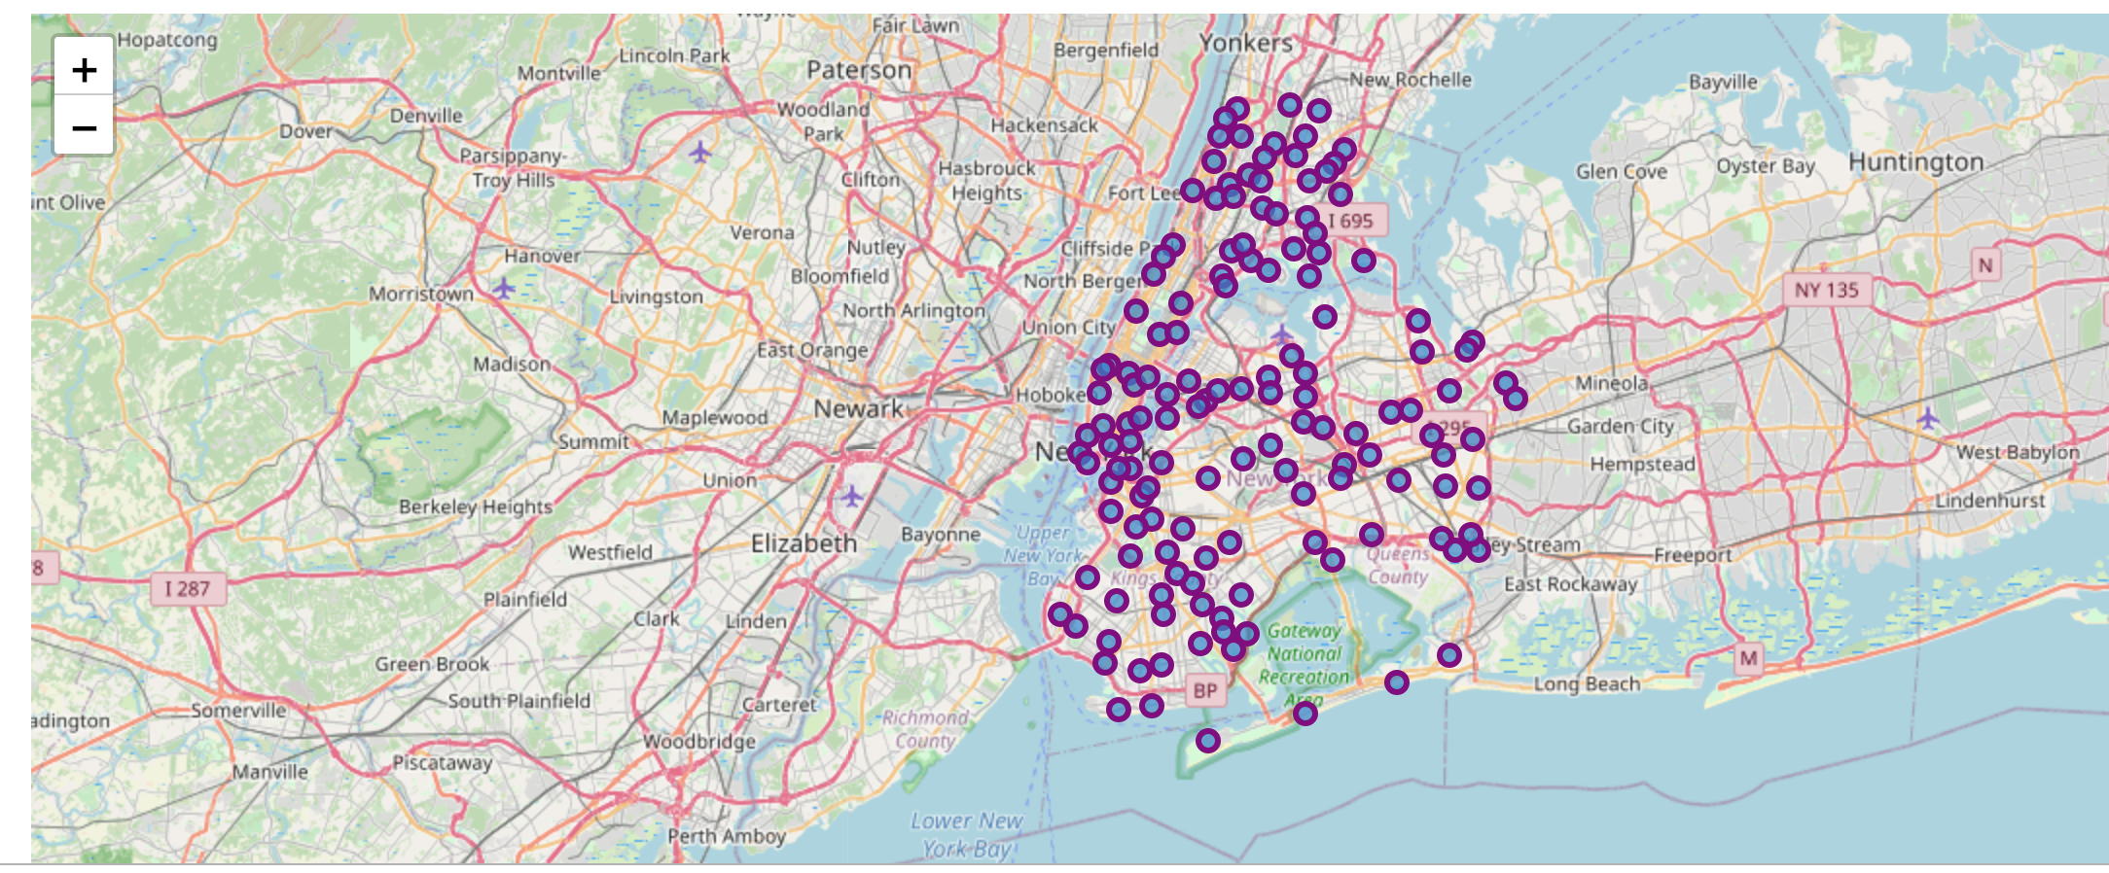
Visualization using Maps and Plots
For the below visualization, done by using coordinates, Python Folium library has been used.

Slide 9
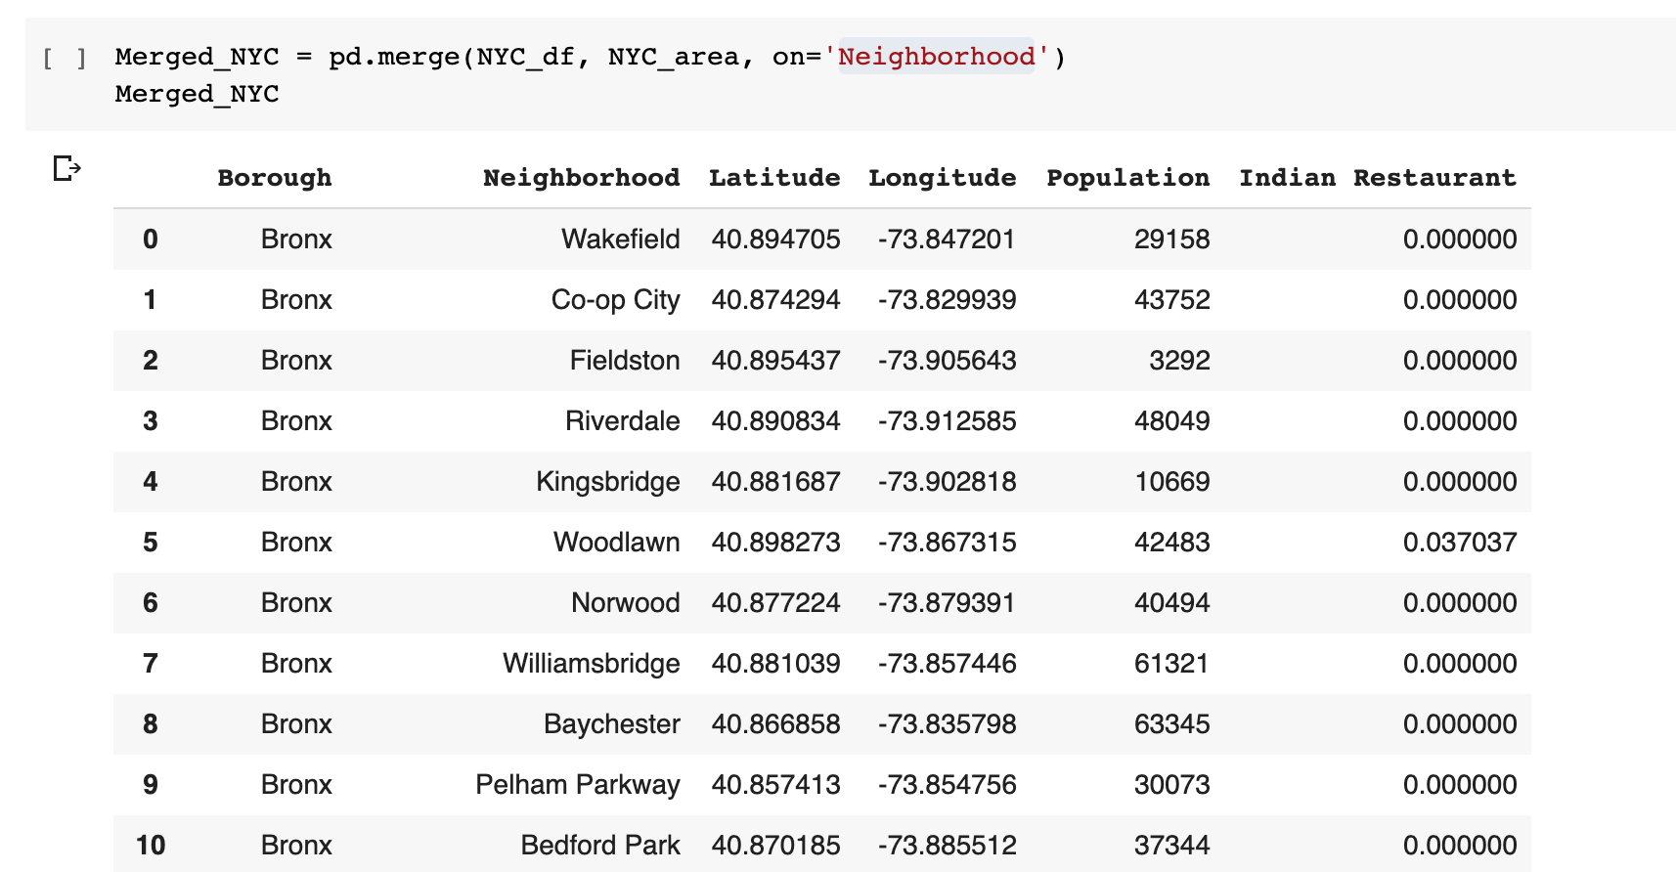
Visualization using Maps and Plots Contd.
One hot encoding will be performed for knowing the venue categories, then that dataframe will be merged with the NYC DataFrame with latitude & longitude information on neighborhood.

Slide 10
Visualization using Maps and Plots Contd.
One hot encoding will be performed for knowing the venue categories, then that dataframe will be merged with the NYC DataFrame with latitude & longitude information on neighborhood.

Slide 11
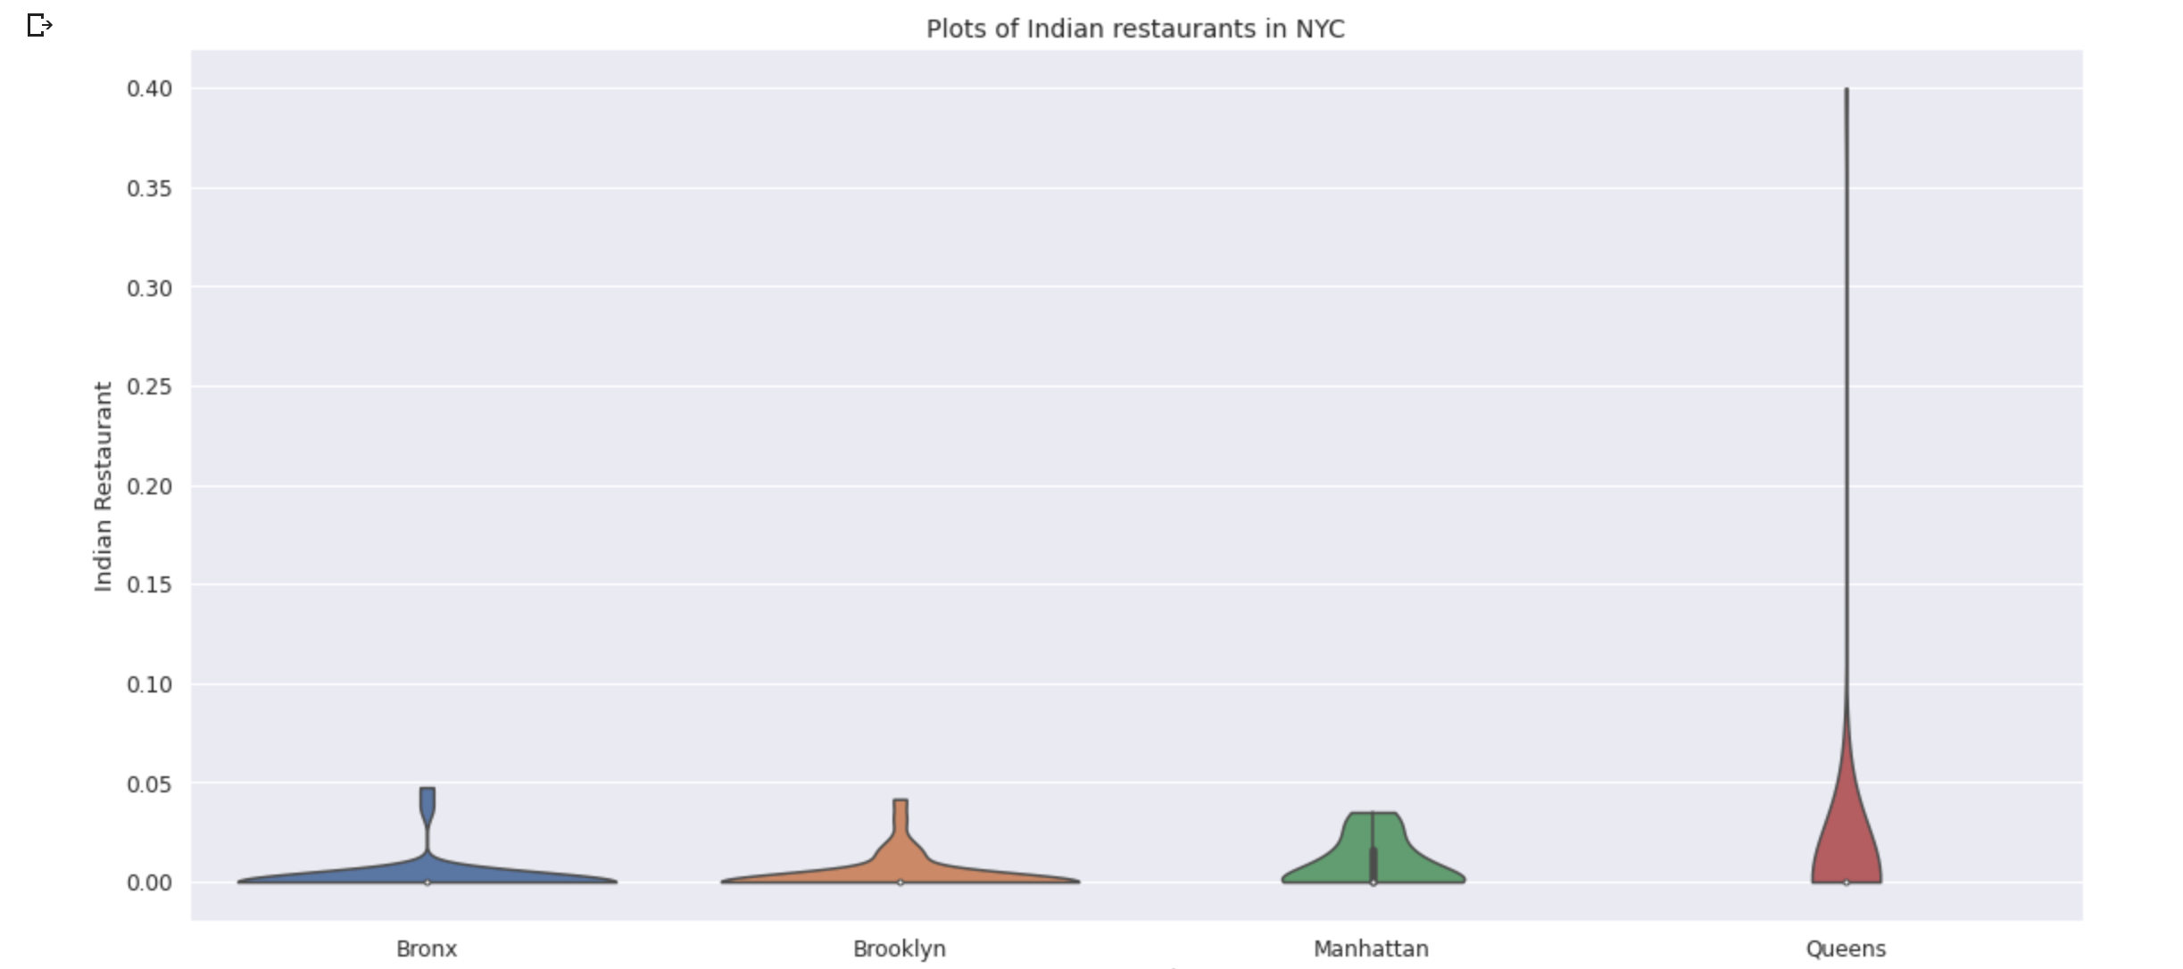
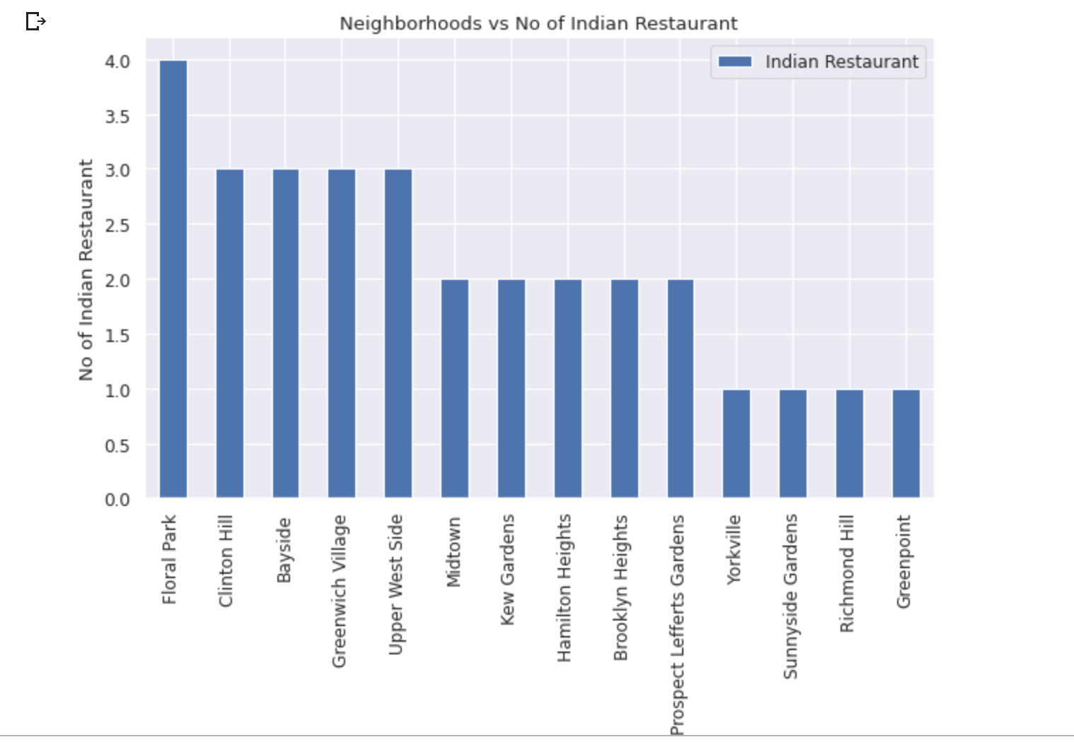
Using Plots
With the help of the violin plot we can identify the boroughs with densely populated Indian restaurants. It is drawn using a seaborn library to show the distribution of Indian restaurants in different boroughs.

Slide 12
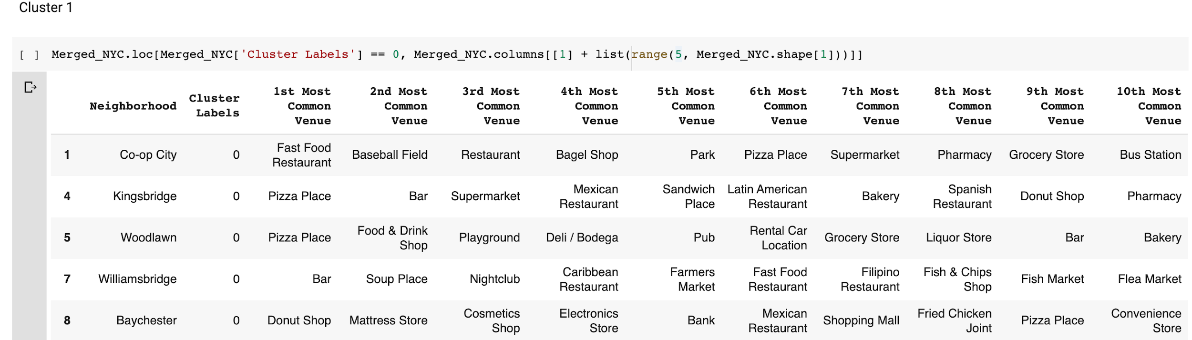
Examining Clusters
Cluster 1:
Cluster 1 especially likes Fast Food, burger Joints. So, the crowd from these neighborhoods may not show interest towards Indian restaurants, having said that these neighborhoods will be good for having an Indian fast food place or a snack place.

Slide 13
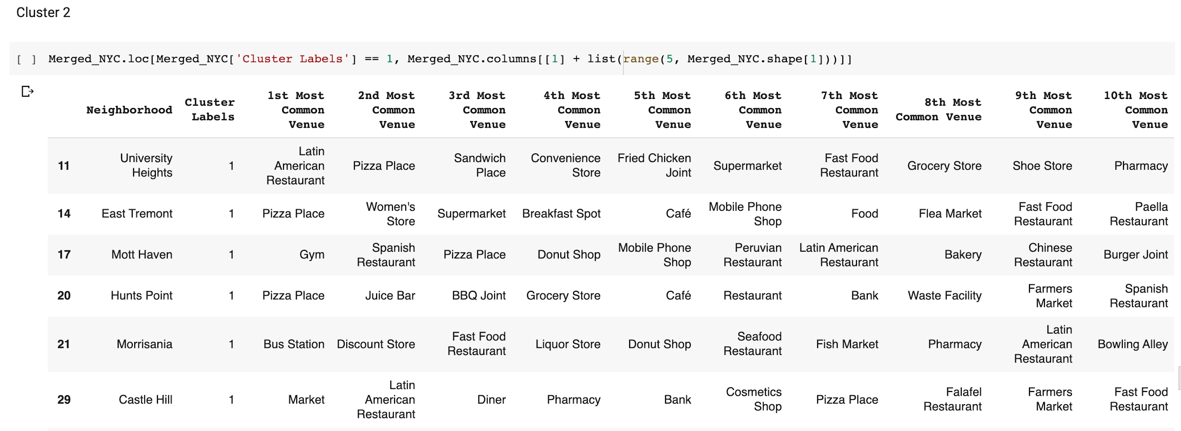
Examining Clusters Contd.
Cluster 2:
This cluster shows that the below neighborhoods already have an amalgam of multi cuisine restaurants. Among those neighborhoods, Morrisania neighborhood has Bus Station as the most common venue, so we can think of having an Indian restaurant, which will help people to commute easily also there is no Indian restaurant in that neighborhood.

Slide 14
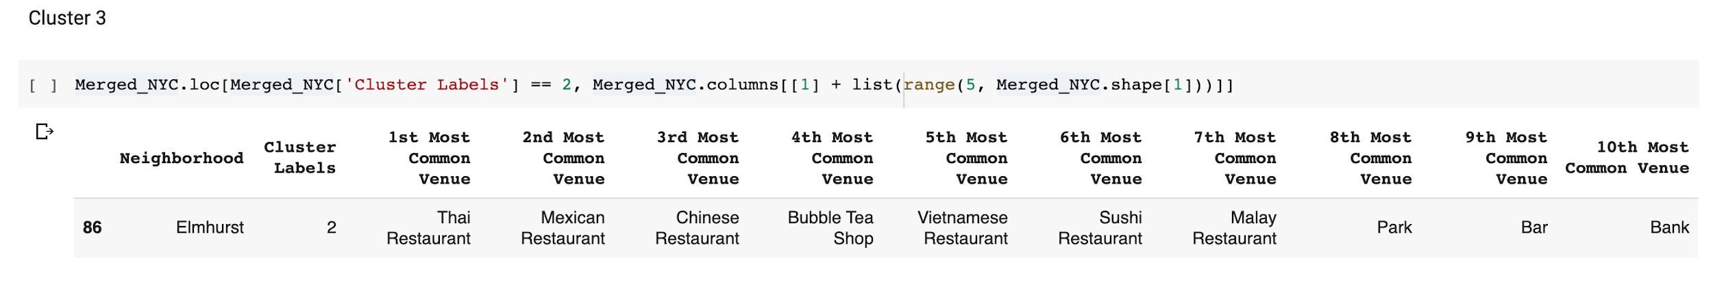
Examining Clusters Cont.
Cluster 3:
Cluster 3 is a center full of restaurants and bars specially with Asian touch. So, having an Indian restaurant in this neighborhood may not be wise.

Slide 15
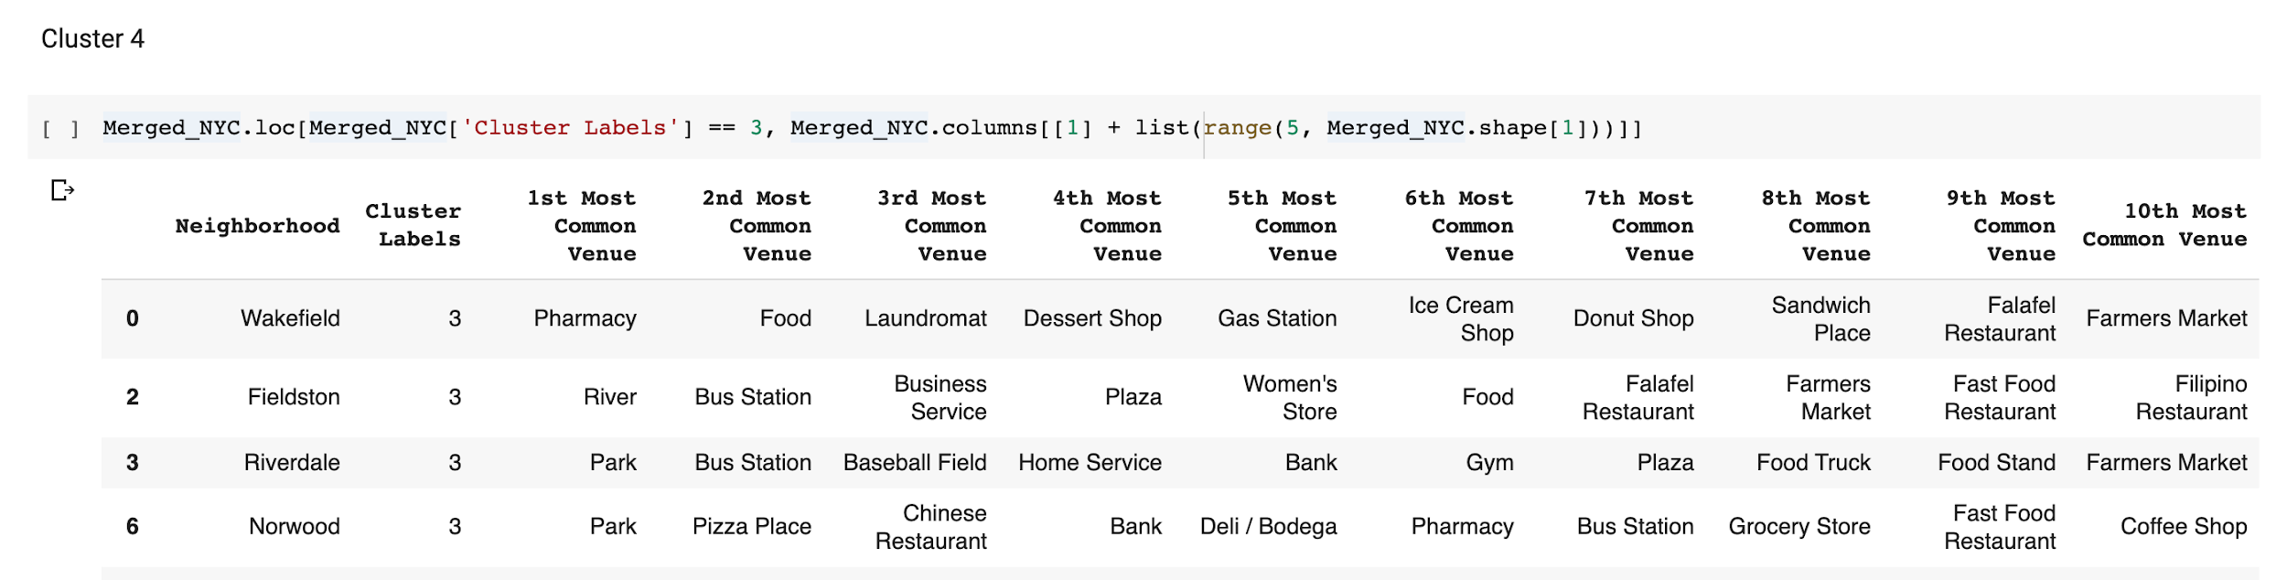
Examining Clusters Contd.
Cluster 4:
Cluster 4 is also full of fast food places, just like cluster 1. The crowd here may not like a proper Indian restaurant.

Slide 16
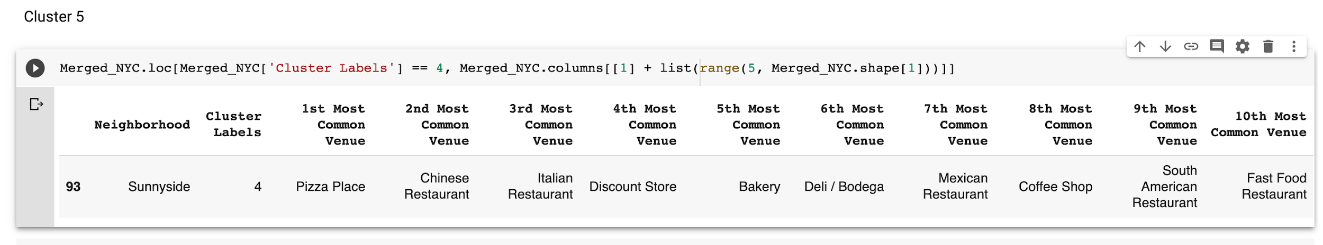
Examining Clusters Contd.
Cluster 5:
Cluster 5 does not have any significant restaurants with Asian touch and there is no Indian restaurant. So having an Indian restaurant might be a good idea since there is less competition and can give a higher number of customers.

Slide 17
Discussion
In this project, we started off with the business problem of identifying a good neighborhood to open a new Indian restaurant. To achieve that we looked into all the neighborhoods in New York City, analysed each neighborhood & number of Indian restaurants in those neighborhoods to come to conclusion about which neighborhood would be a better spot. Below are the findings:
It has been identified that only Queens, Manhattan, Brooklyn and Bronx have a high amount of Indian restaurants with the help of Violin plots between Number of Indian restaurants in the Borough of New York City.
After careful consideration it is a good idea to open a new Indian restaurant in the Sunnyside neighborhood since it has no Indian restaurants in the neighborhoods and also suffers from other restaurants too, which gives a higher number of customers and possibly lower competition.

Slide 18
Conclusion
According to this analysis, the Sunnyside neighborhood will provide the least competition for the new upcoming Indian restaurant as there is very little Indian restaurants spread or no Indian restaurants in few neighborhoods.
Even Though there are lots of areas where it can be improved yet this analysis has certainly provided us with some good insights, preliminary information on possibilities & a head start into this business problem by setting the step stones properly.
We have used many python libraries and Foursquare API to fetch the data , to manipulate the contents & to analyze and visualize those datasets, then got a good amount of data from Wikipedia which we scraped with help of Wikipedia python library and visualized using various plots present in seaborn & matplotlib. We also applied machine learning techniques to predict the output given the data and used Folium to visualize.

